Slide 1

Introduction to NLP.

Slide 2
What is Natural Language Processing?
NLP stands for Natural Language Processing. It is a branch of artificial intelligence that focuses on the interaction between computers and humans in natural language. NLP techniques are used to analyse, understand, and generate human language.

Slide 3
Examples of NLP.
Personal assistants: Siri, Cortana, and Google Assistant.
Auto-complete: In search engines (e.g. Google).
Spell checking: Almost everywhere, in your browser, your IDE (e.g. Visual Studio), desktop apps (e.g. Microsoft Word).
Machine Translation: Google Translate.

Slide 4
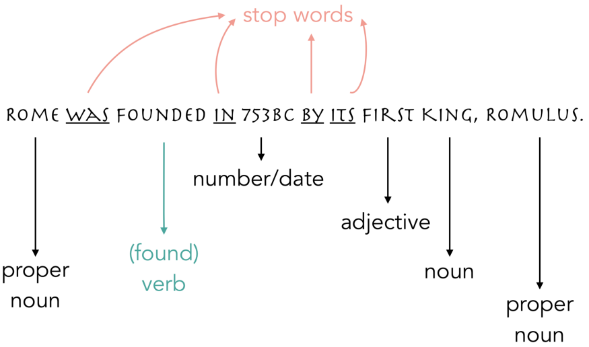
How does it work?
Whatever text or sentence is fed to a machine, it will need to be simplified first, and this can be done through tokenization and lemmatization.
Notes:
Note: to run the examples below, you will need to have nltk library installed. If you don’t have it, just run pip install nltk in your shell and nltk.download() in your notebook before starting

Slide 5
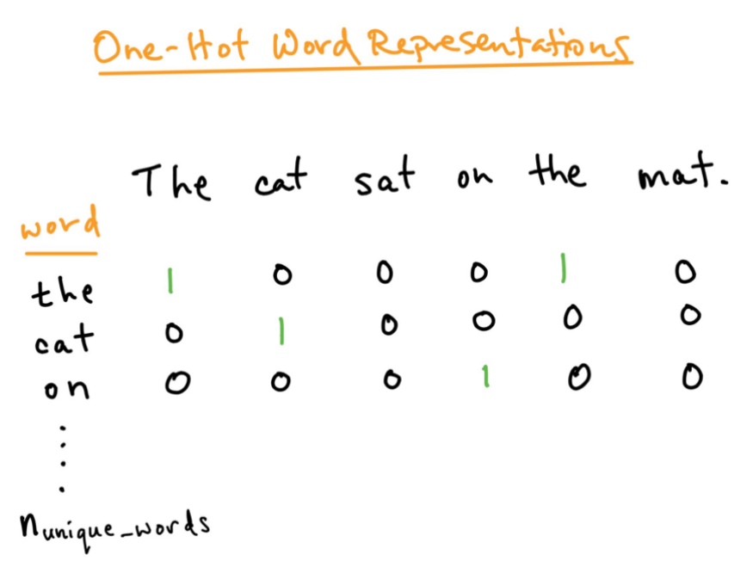
How Computers Understand Text?
Computers understand numbers, but can’t understand characters, words, or sentences, so an intermediate step is needed before building NLP models, which is text representation.

Slide 6
Challenges in Natural Language Processing
Lexical Ambiguity: This is the first level of ambiguity that occurs generally in words alone. For instance, when a code is given a word like ‘board’ it would not know whether to take it as a noun or a verb. This causes ambiguity in the processing of this piece of code.
Syntax Level Ambiguity: This is another type of ambiguity that has more to do with the way phrases sound in comparison to how the machine perceives it. For instance, a sentence like, ‘He raised the scuttle with a blue cap’. This could mean one of two things. Either he raised a scuttle with the help of a blue cap, or he raised a scuttle that had a red cap.
Referential Ambiguity: References made using pronouns constitute referential ambiguity. For instance, two girls are running on the track. Suddenly, she says, ‘I am exhausted’. It is not possible for the program to interpret, who out of the two girls is tired.

Slide 7
Components of NLP
Natural Language Understanding (NLU): The understanding phase of the processing is responsible for mapping the input that is given in natural language to a beneficial representation. It also analyzes different aspects of the input language that is given to the program.
Natural Language Generation (NLG): The generation phase of the processing is used in creating Natural Languages from the first phase. Generation starts with Text Planning, which is the extraction of relevant content from the base of knowledge. Next is the Sentence Planning phase where required words that will form the sentence are chosen. Ending with Text Realization is the final creation of the sentence structure.

Slide 8
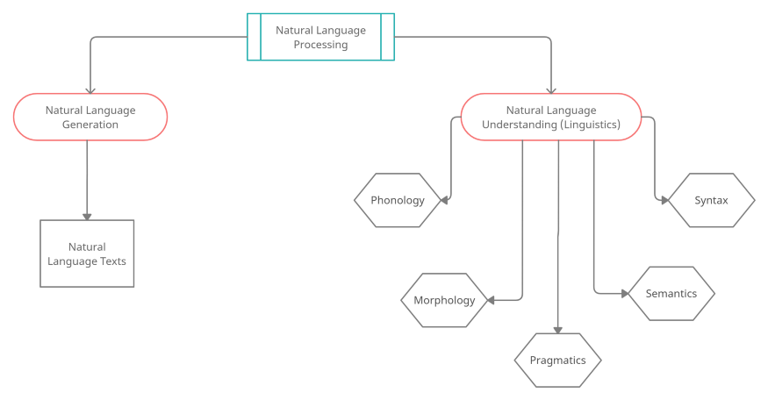
Components of NLP

Slide 9
Building a Natural Language Processor.
Lexical Analysis: Processing of Natural Languages by the NLP algorithm starts with identifying and analyzing the input words’ structure.
Syntactic Analysis / Parsing: Once the sentences’ structure is formed, syntactic analysis works on checking the grammar of the formed sentences and phrases.
Semantic Analysis: In the semantic analysis process, the input text is now checked for meaning, i.e., it draws the exact dictionary of all the words present in the sentence and subsequently checks every word and phrase for meaningfulness.
Discourse Integration: Every sentence should have a relationship with its preceding and succeeding sentences. These relationships are checked by Discourse Integration.
Pragmatic Analysis: Once all grammatical and syntactic checks are complete, the sentences are now checked for their relevance in the real world.

Slide 10

Introduction to ChatGPT
ChatGPT is a pre-trained language model developed by OpenAI. It is based on the GPT (Generative Pre-trained Transformer) architecture and is trained on a large dataset of text data. ChatGPT can generate human-like text, and can be fine-tuned on specific tasks such as language translation, question answering, and conversation generation. It is designed to be a flexible and powerful tool for natural language processing tasks.

